Slide 1
Question 1:
Do campaign contributions predict electoral success?

Slide 2
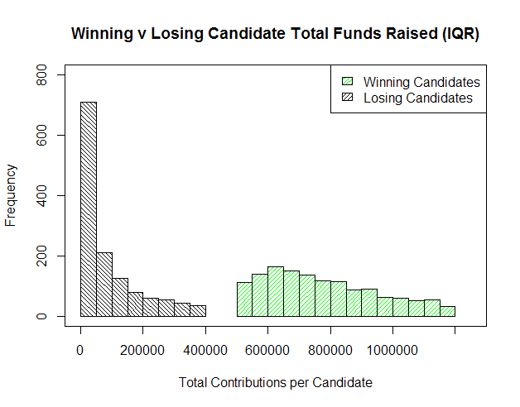
Winning candidates raise more money than losing candidates

Slide 3

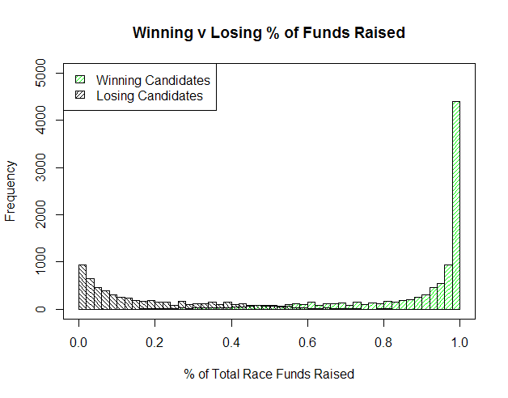
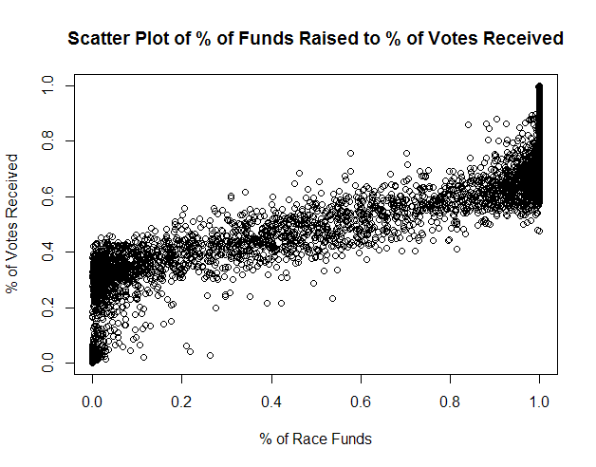
Funding is highly correlated with electoral success:

Slide 4
Association rules show the same pattern, with a caveat…
Rule | Support | Confidence | Description
{CANDTOTALLEVEL=Very Low} => {WINNER=0} | 0.301615 | 0.724322104 | 72.4% of candidates who raised very low amounts lost
{WINNER=0} => {CANDTOTALLEVEL=Very Low} | 0.301615 | 0.748556386 | 74.9% of losing candidates raised very low amounts of money
{CANDTOTALLEVEL=High} => {WINNER=1} | 0.055601177 | 0.779002876 | 77.9% of candidates who raised a high amount won
{INCUMBENT=1} => {WINNER=1} | 0.509512078 | 0.953451146 | 95.3% of incumbents won reelection
{WINNER=1} => {INCUMBENT=1} | 0.509512078 | 0.853352436 | 85.3% of winners were incumbents
{CANDTOTALLEVEL=Very Low} => {INCUMBENT=0} | 0.314309177 | 0.754806902 | 75.5% of candidates who raised a very low amount were challengers
{INCUMBENT=0} => {CANDTOTALLEVEL=Very Low} | 0.314309177 | 0.675044092 | 67.5% of challengers raised a very low amount of funding
{CANDTOTALLEVEL=High} => {INCUMBENT=1} | 0.05460891 | 0.765100671 | 76.5% of candidates who raised a high amount of funding were incumbents
{CANDTOTALLEVEL=Mid-High} => {INCUMBENT=1} | 0.111510299 | 0.70116179 | 70.1% of candidates who raised a mid-high amount were incumbents
Difficult to separate out effects of Incumbent variable from Winner variable

Slide 5
Question 2:
Do campaign contributions predict an industry’s performance?

Slide 6

We couldn’t really answer this question…
Data weren’t binned in a manner conducive to answering it
Industry bins were too wide; nearly every candidate received contributions from nearly every industry
Also, no stock data for some major contributors (nonprofits, not publicly traded)
Green cluster: candidates primarily supported by nonprofits and the financial industry.

Slide 7
Conclusion
What has been the key things we have been able to conclude?

Slide 8
The evolution of our question
At First
We wanted to see if political contributions by industries to specific candidates had any bearing on election results
We also wanted to see if the election results had any specific impact on the market as a whole.
After Part 2
The idea morphed into looking at total campaign contributions and other aspects that led to candidates winning

Slide 9
Some takeaways
Many of our conclusions supported already expected conclusions, but no major breakthroughs that we we were hopping for
Stocks aren’t significantly affected by election results
If you’re running for congress, make sure to be an incumbent

